Slide 1
Multimodal Social Signal Processing including Voice Analysis for Real-Time Stress Detection and Mental Health Support
Professor Shun Shiramatsu.
HOSSAIN Syeda Tanzina(M2)

Slide 2
Content
Introduction
Overview of System
Background research
Social Signal Processing
Mental Health Care System
System design
Texual analysis with whisper and GPT-4o
Audio analysis with LSTM
Future work
Conclusion

Slide 3
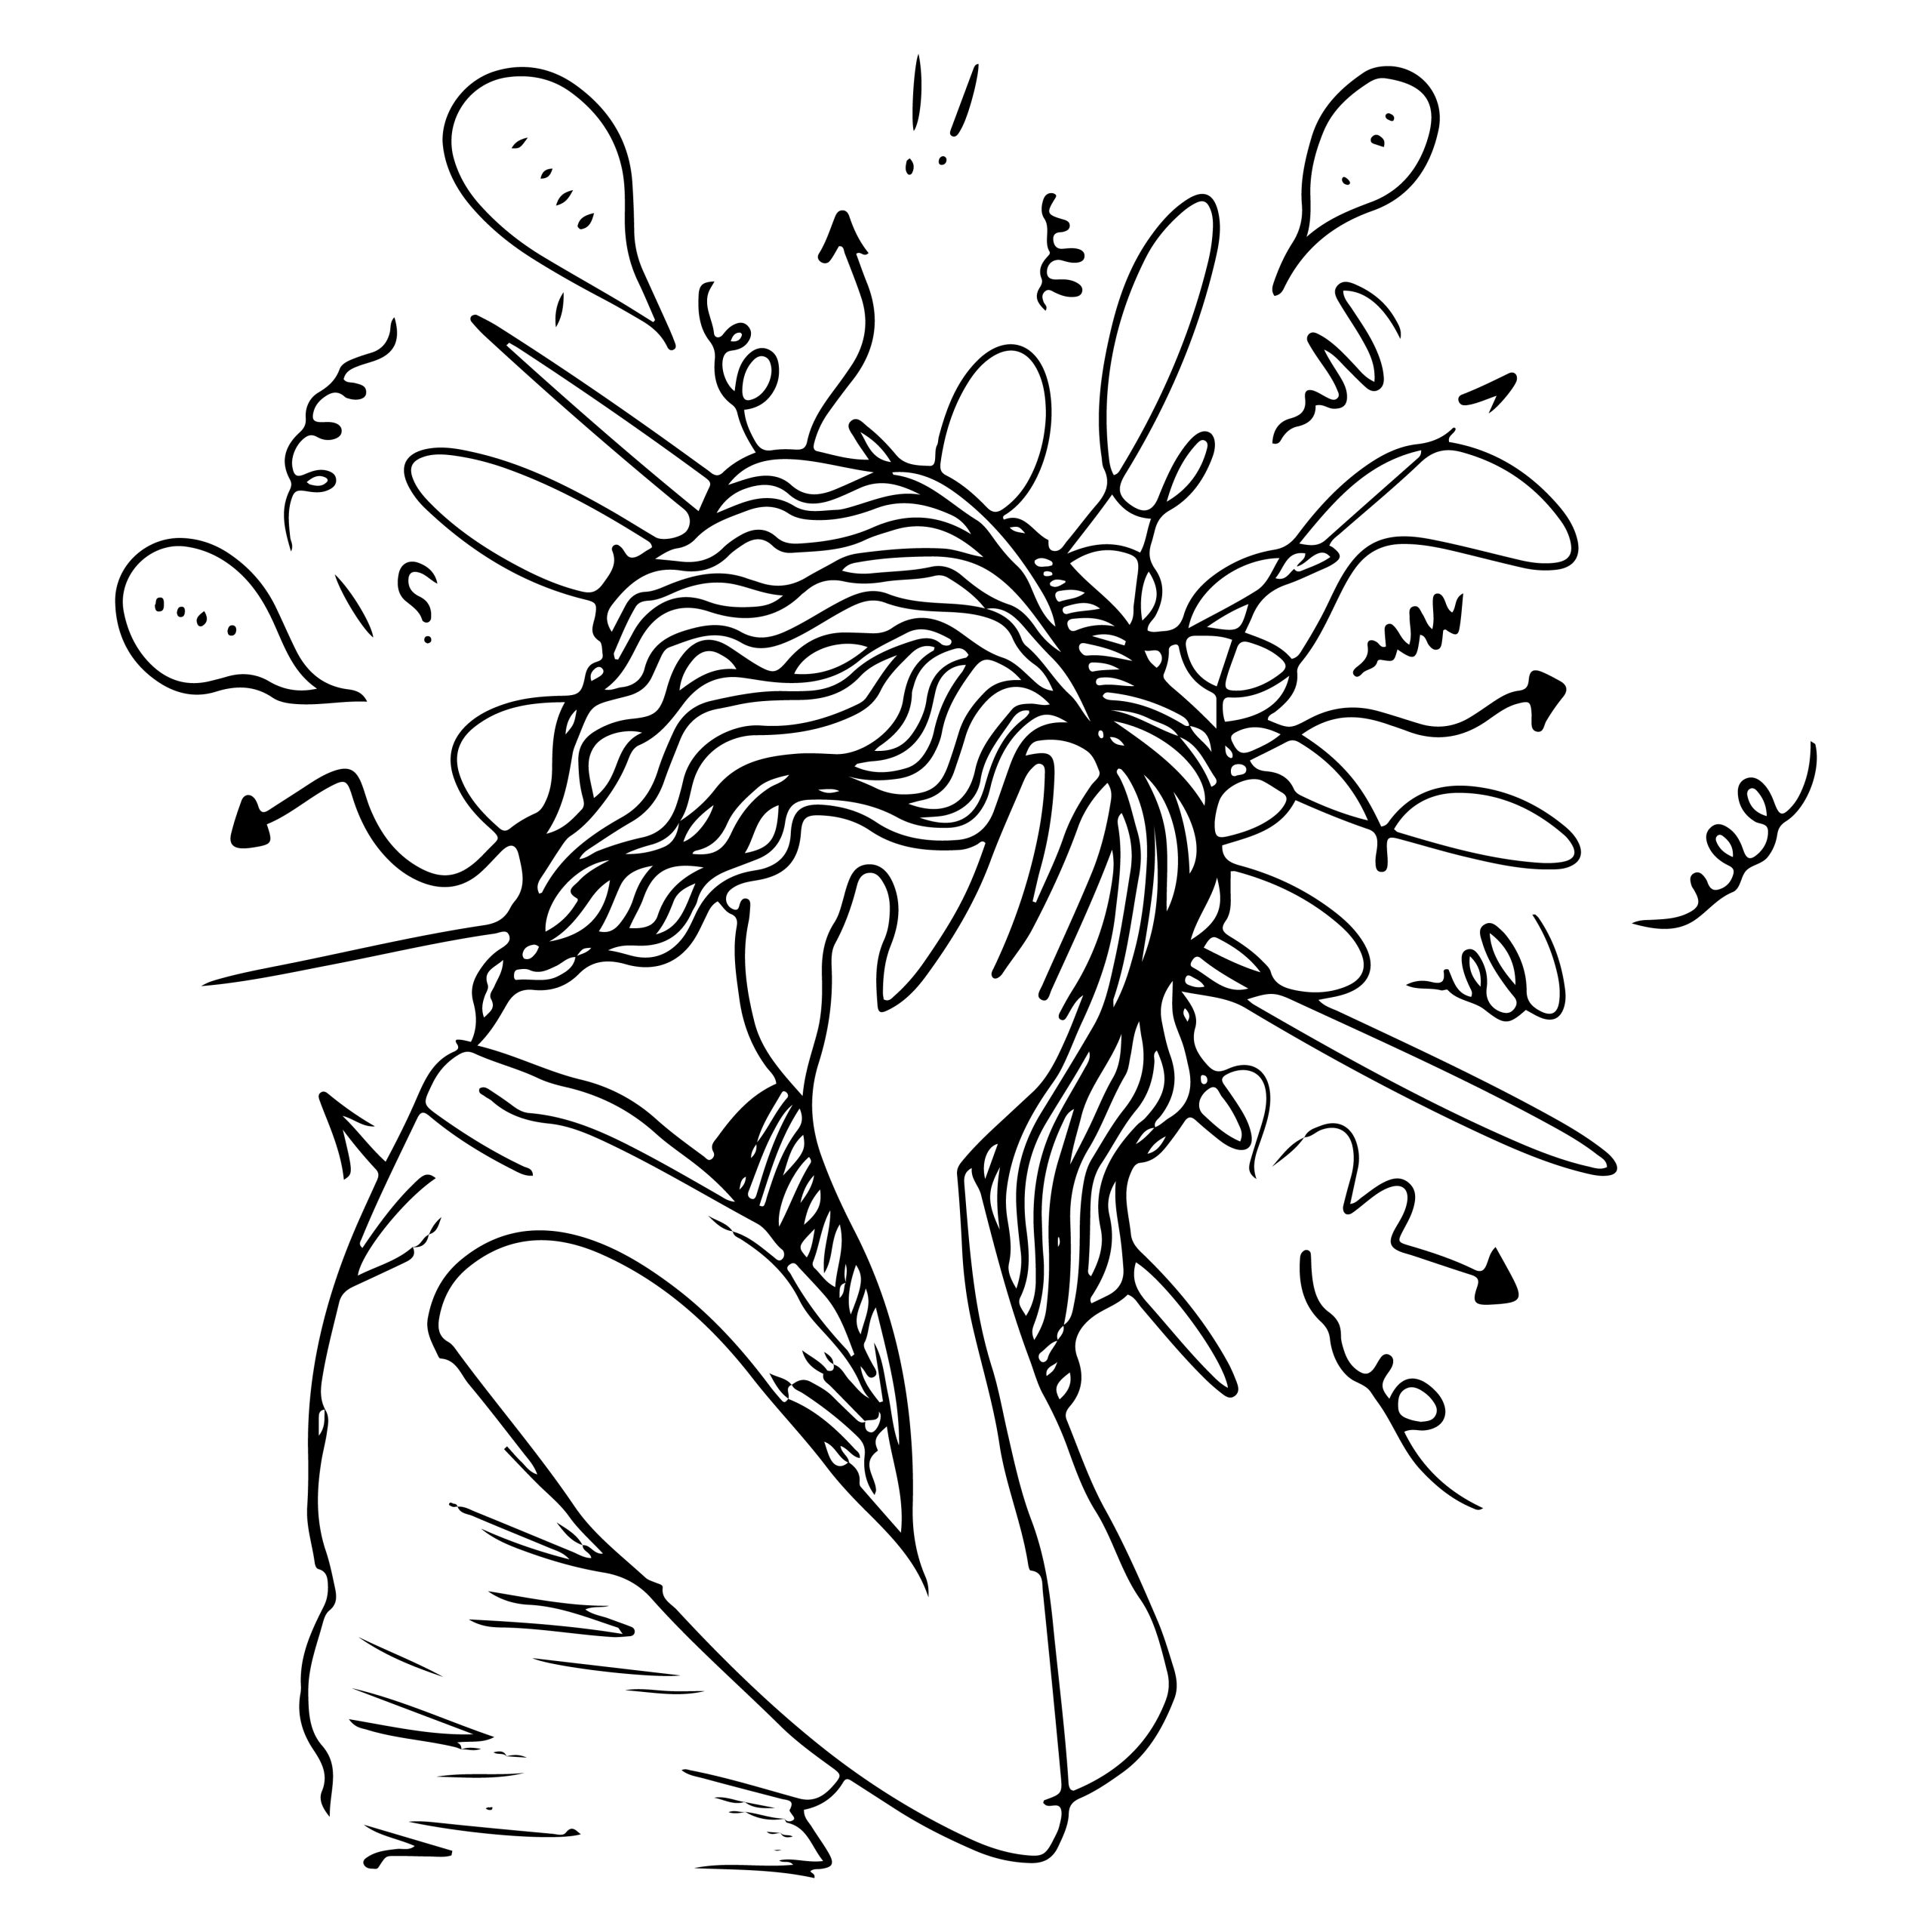
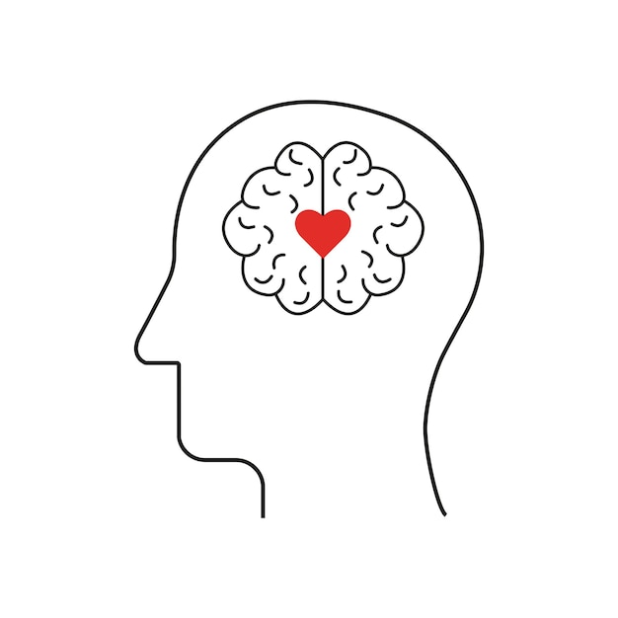

Introduction to Problem
Background
Challenge
Need
There’s a demand for real-time, objective, and non-invasive stress detection to enhance mental health support systems.
In 2023, the number of mental health disorder in Japan reached a record high,883 cases.
Traditional methods of detecting stress often rely on self-reported measures, which can be inaccurate or delayed.
3
Notes:
(HCAMag) Nippon.com

Slide 4
Background research
Title | Year | Approach | Limitations
Investigating Large Language Models’ Perception of Emotion Using Appraisal Theory | 2023 | Appraisal and coping theory using the Stress and Coping Process Questionnaire (SCPQ) | SCPQ is that scenarios are hypothetical, people behave and appraise them differently if they were real.
The DEEP Method: Towards Computational Modeling of the Social Emotion Shame driven by Theory, Introspection, and Social Signals | 2023 | It combines social signals, verbalized introspection information, context information, and theory-driven knowledge. | It requires time- consuming data collection and analysis with trained interviewers and raters
Traditional stress detection methods often rely on single-modal data, such as text or audio.
Traditional methods of stress assessment often require in-person clinical evaluations.
4
Notes:
advancements in Artificial Intelligence (AI) have paved the way for automated stress detection systems.

Slide 5
Overview
Integration: The system will be integrated with multimodal Large Language Models (LLMs) like GPT-4 for enhanced detection.
Outcome: Supporting metacognition and mental health care through personalized feedback and dialogue.
Goal: To develop a system that estimates and visualizes user stress levels using Social Signal Processing (SSP) techniques, including voice analysis for both linguistic (text-based) and paralinguistic (audio-based).
5

Slide 6
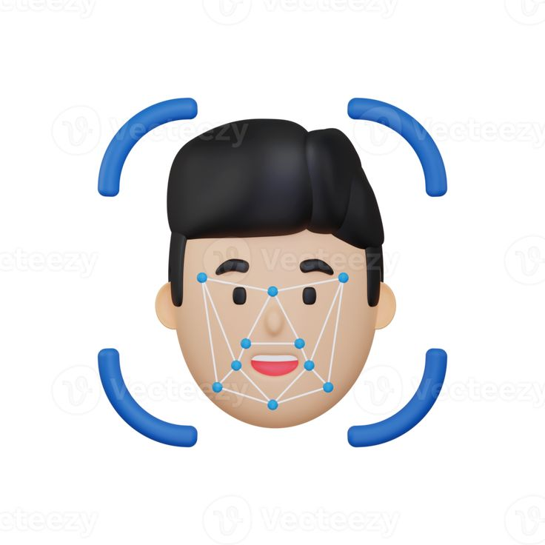


Social Signal Processing Techniques
Facial Expression Recognition: Detects emotions (anger, sadness, happiness) through micro-expressions and facial cues.
Voice Feature Analysis: Analyses pitch, tone, speed, and other vocal elements to assess stress and emotional states.
Behavioral Cues: SSP also studies non-verbal behavior, including gestures, posture, and eye contact, to interpret social and emotional dynamics in real-time
6

Slide 7
Multimodal LLM Integration
GPT-4o:Powerful in understanding context from multimodal inputs (text, voice, and visual data).
LLM Capabilities: Enhances interpretation of stress-related signals.
Adapts to personalized mental health profiles and patterns over time.
Output: Generates real-time suggestions for stress management ( relaxation techniques, cognitive reframing).
7

Slide 8
Mental Health Care System
Personalized Interaction: Tailored conversations based on user stress levels and emotional state.
Metacognition Support: Encourages users to reflect on their emotions and behaviour, improving emotional awareness and self-regulation.
Therapeutic Guidance: Offers therapeutic dialogue techniques such as cognitive-behavioural interventions, mindfulness, and self-compassion.
8

Slide 9
Use Cases and Applications
Clinical settings: Real-time stress monitoring for patients in mental health care.
Workplace wellness: Employee stress tracking and management to improve productivity and well-being.
Personal use: Individuals managing daily stress for improved emotional regulation.
Educational settings: Helping students manage academic stress in real time.
9

Slide 10
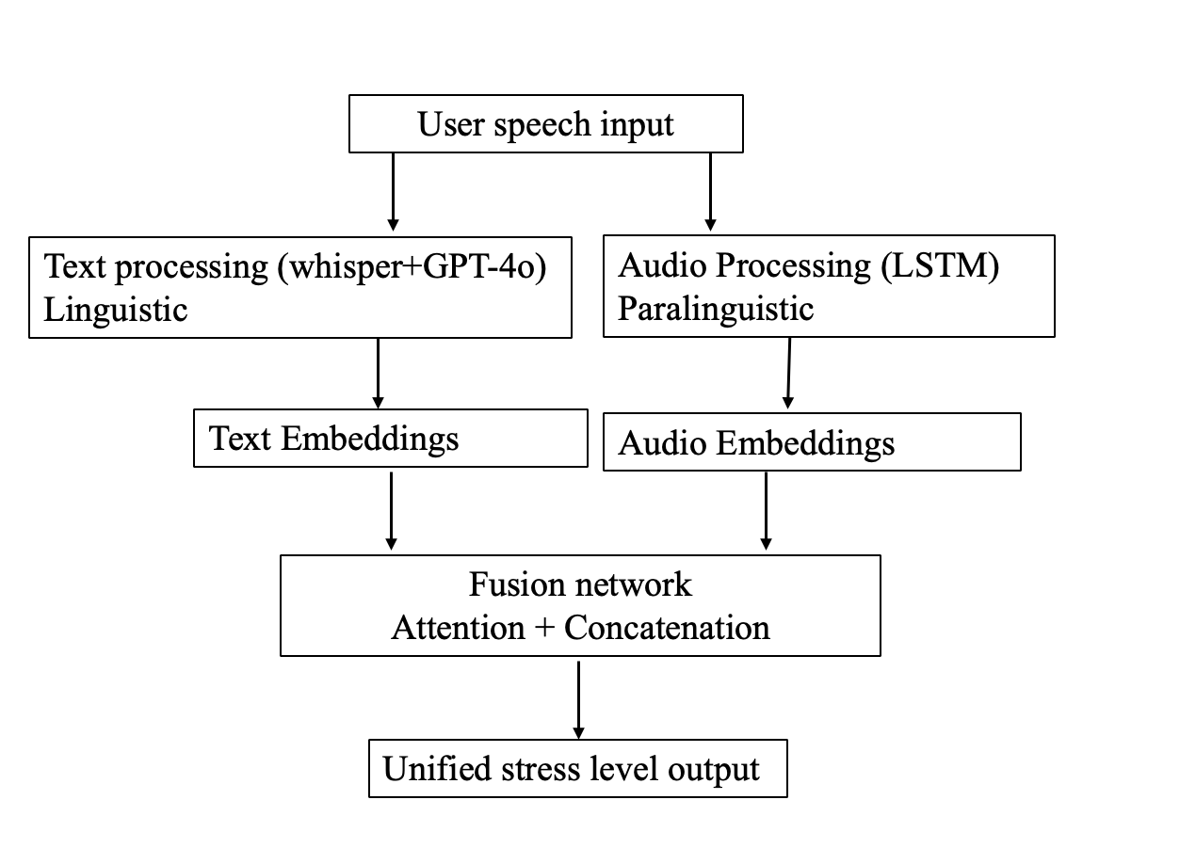
System Design
The proposed system comprises three primary modules:
Text Processing with GPT-4o: This module transcribes user speech into text and performs language analysis to detect stress-related emotions, such as sadness, anger, or fear. It identifies specific words and phrases associated with stress, using GPT-4's capabilities to interpret context and emotional nuance.
Voice Analysis Using LSTM and Social Signal Processing: The LSTM network processes temporal patterns in the audio data, such as pitch, frequency, and amplitude variations, which are indicative of stress. SSP techniques further enrich the analysis by capturing vocal dynamics related to emotional intensity.
Fusion and Stress Level Estimation: Outputs from both text and audio analyses are combined using a fusion network that integrates linguistic and paralinguistic data. The system applies attention mechanisms to focus on the most relevant features for stress estimation, producing a unified stress level.
10

Slide 11
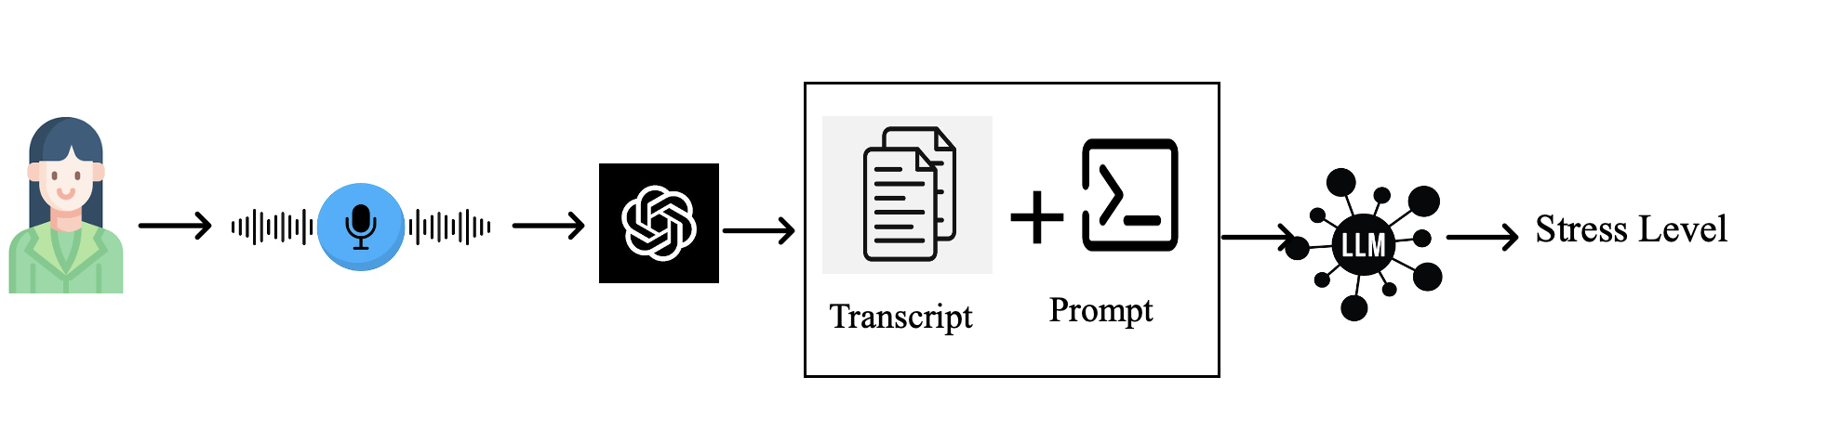
Texual analysis
Input: Voice feature analysis (via microphone)
Processing: Social Signal Processing (SSP) for real-time stress detection.
GPT-4 multimodal integration for interpreting stress patterns.
Output: Stress level.
11

Slide 12

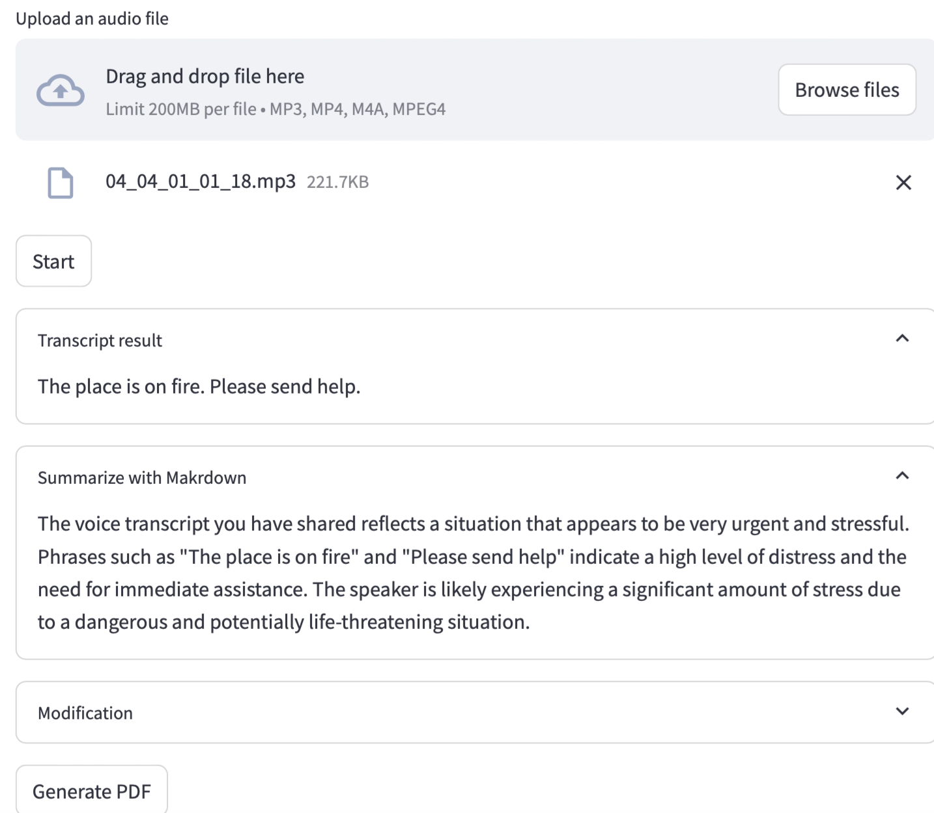
Stress Texual Analysis from audio
Upload Audio file
Audio file
Transcript result
Summary analysis

Slide 13
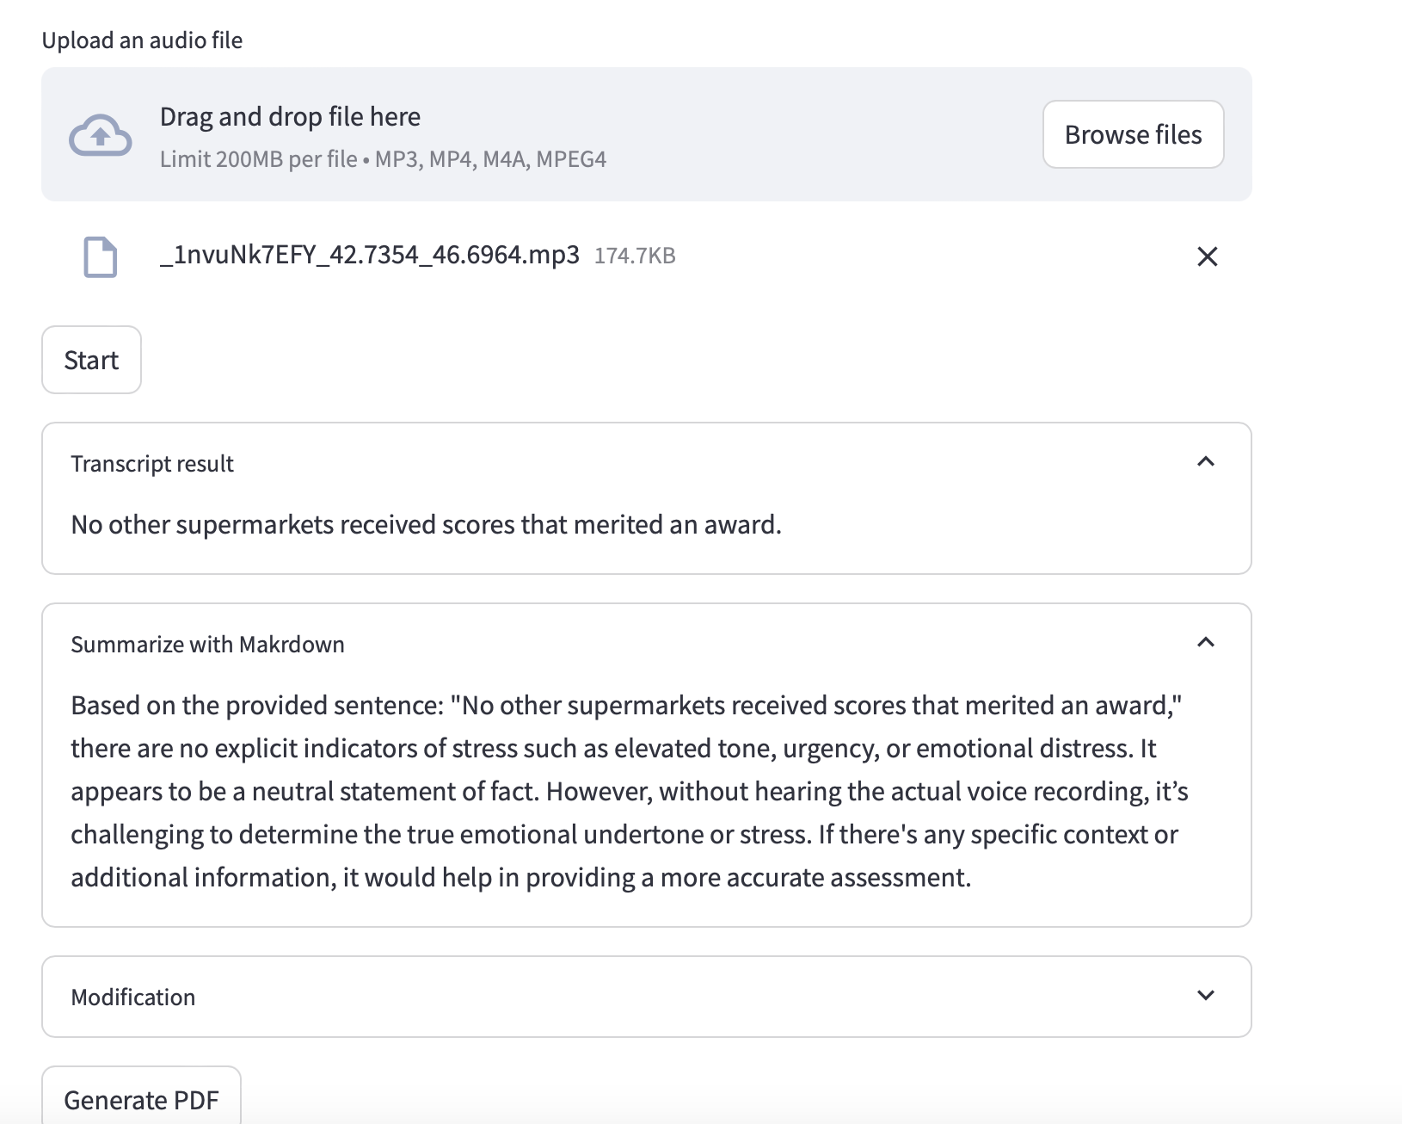
Stress Texual Analysis from audio
13

Slide 14
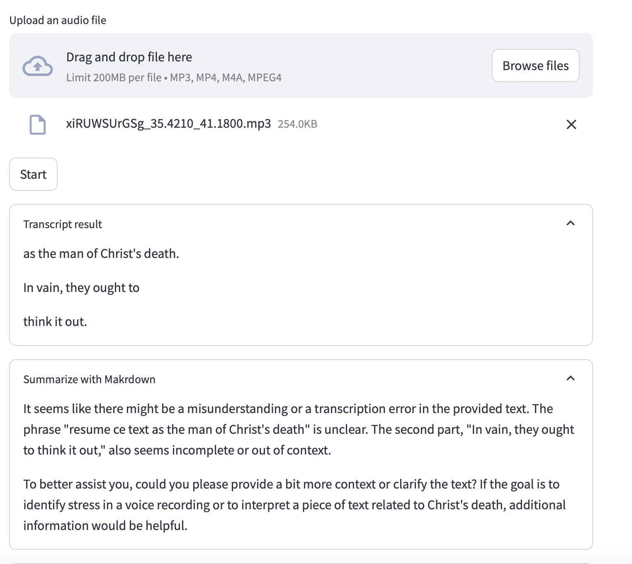
Stress Texual Analysis from audio

Slide 15
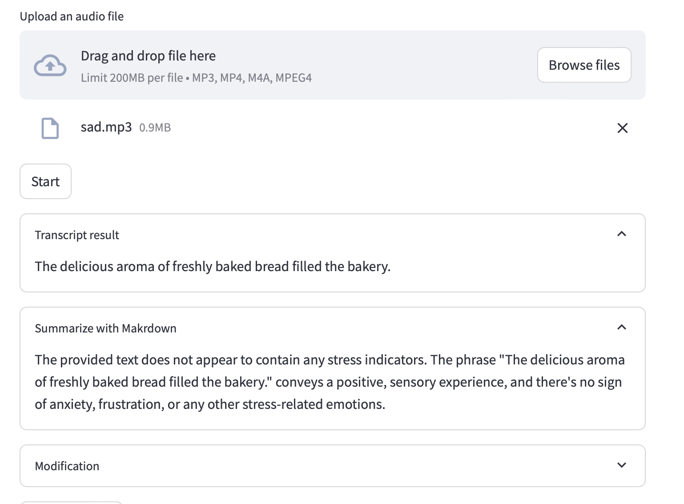
Stress Texual Analysis from audio
14

Slide 16
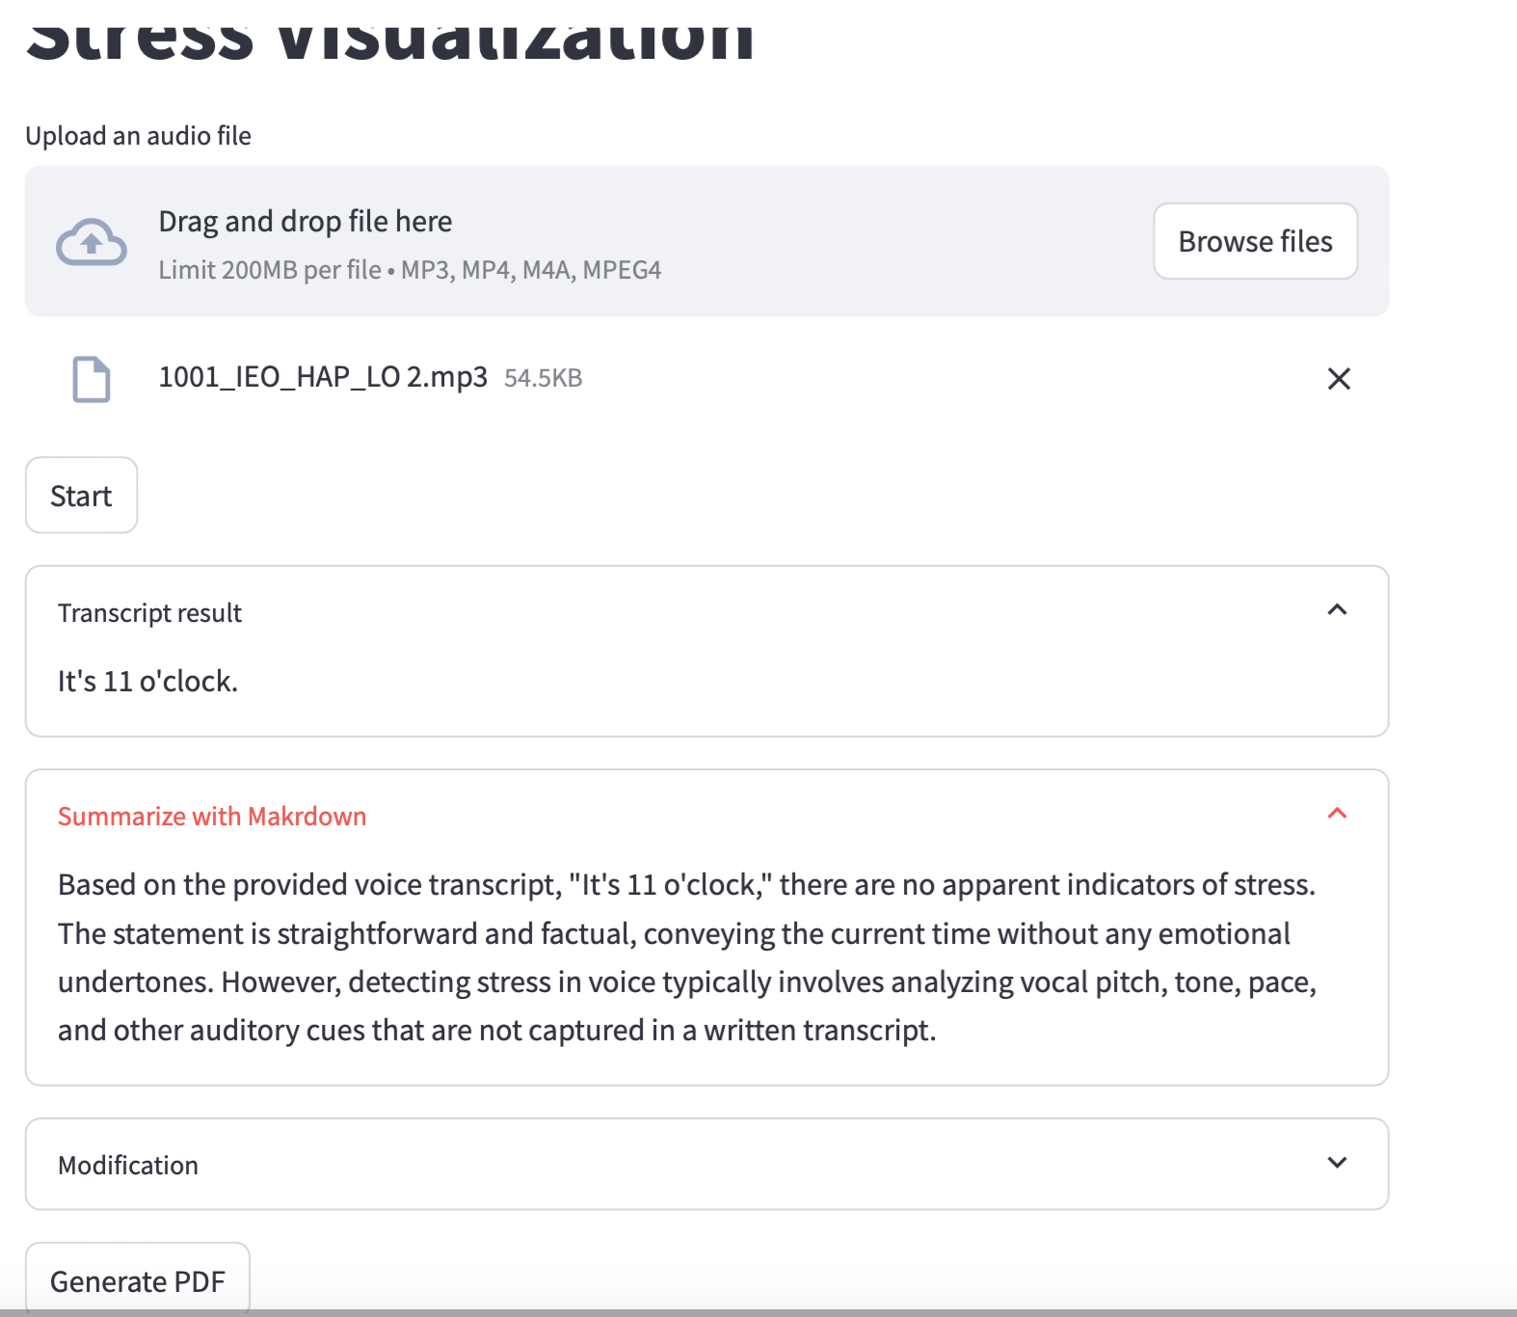
Stress Texual Analysis from audio

Slide 17
Explanation of texual analysis (verbal signal)
1. Audio capture: The system capture the audio.
2. Transcription(textual network)
Speech to text model : A raw audio is passed into speech recognition API
OpenAI`s Whisper to convert into text.
This is where the spoken input ("The place is on fire...") is converted into a textual transcript.
Here, I used faster_whisper for audio engine.
Text formatting: The transcript may be cleaned or standardized (removing unnecessary pauses or artifacts) to ensure it is ready for the next step.
15
Notes:
string manipulation techniques like tokenization

Slide 18
Explanation of Texual Analysis (verbal)
3.Texual analysis
Prompt generation: Once the transcript is ready, a prompt is formulated. The prompt might include instructions to analyse the transcript for emotional content or specific stress indicators. This can be done using a template-based approach or dynamic prompt creation, where certain keywords (example: “fire,” “help”) trigger stress-related prompts.
Prompt+transcript to LLM : The transcript and prompt are fed into an LLM (GPT-4o). This step involves packaging the input as a query that the LLM understands, potentially formatted as {"prompt": "from now you are expert to find any stress in the following voice transcript. "}.
LLM Prcoessing: The LLM processes the prompt and transcript, using its pre-trained knowledge of language patterns, semantics, and emotional cues to analyse the text. The LLM evaluates both the content ("fire," "help") and the context ( the urgency in the sentence structure).
4. Stress level estimation
LLM output ( returns a result that include emotional analysis and potential stress level indicators)
16
Notes:
Current version of visualization is based on text

Slide 19
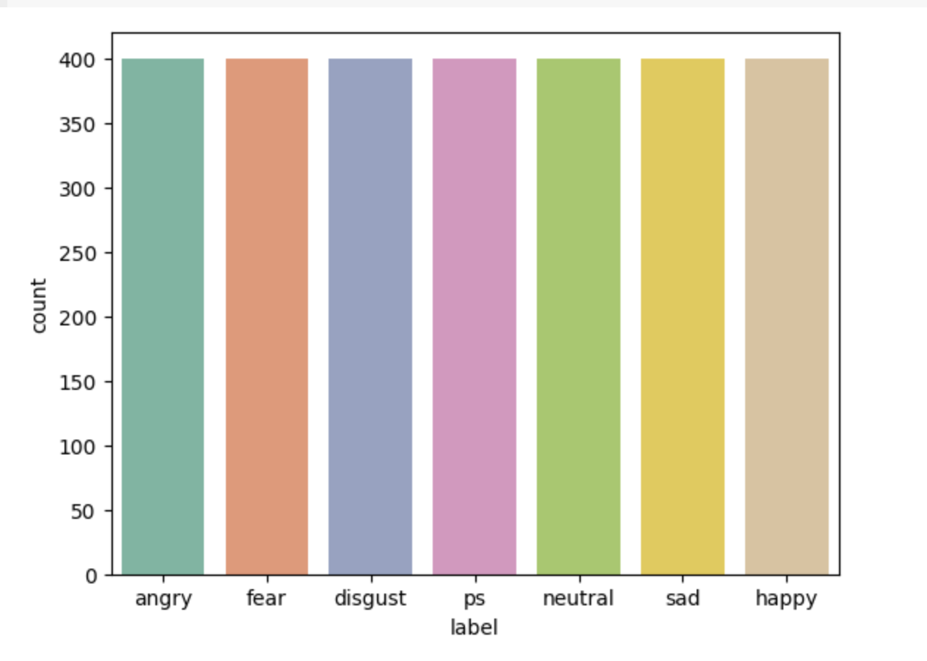
Data collection
TESS dataset consists of 2,800 audio files.
2 speakers×7 emotions×200 sentences=2,800 audio files
Distribution: Each of the seven emotions (angry, disgust, fear, happy, sad, surprise, and neutral) has 400 samples (200 sentences per speaker × 2 speakers).
Labels: Each sample is labeled with one of the seven emotion categories based on the emotional expression in the audio file.
The count plot shows that each emotion category in the dataset has an approximately equal number of samples, which ensures balance in the dataset for training and evaluating emotion recognition models.
Speech emotion recognition based on improved masking EMD and convolutional recurrent neural network[4]
https://www.frontiersin.org/journals/psychology/articles/10.3389/fpsyg.2022.1075624/full
17

Slide 20
Feature Extraction MFCCs (Mel-Frequency Cepstral Coefficients)
MFCC (Mel-Frequency Cepstral Coefficients) are features that represent the short-term power spectrum of a sound.
used in audio and speech recognition tasks because it capture the important spectral properties of sound in a way that is closer to how humans perceive it.
The extract_mfcc function calculates the MFCCs for each audio file.
The function is lambda that calls extract_mfcc on each audio file.
18

Slide 21
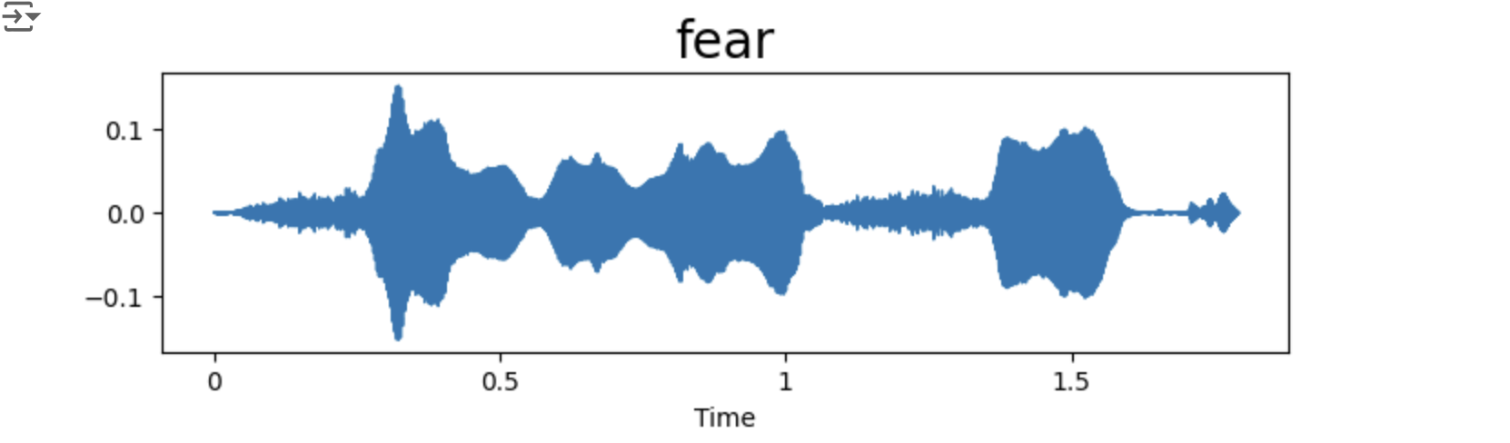
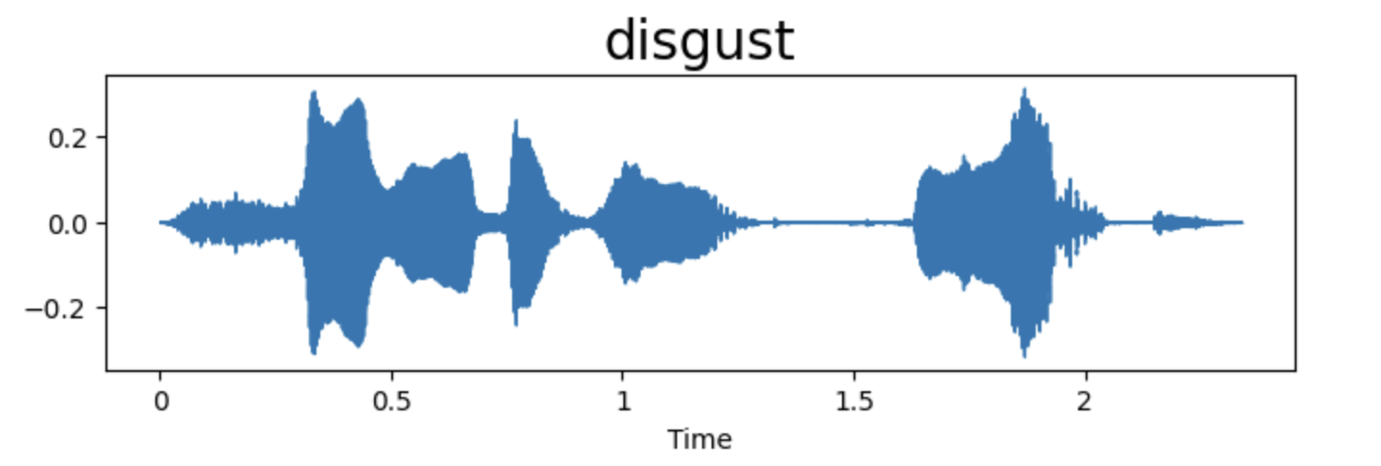
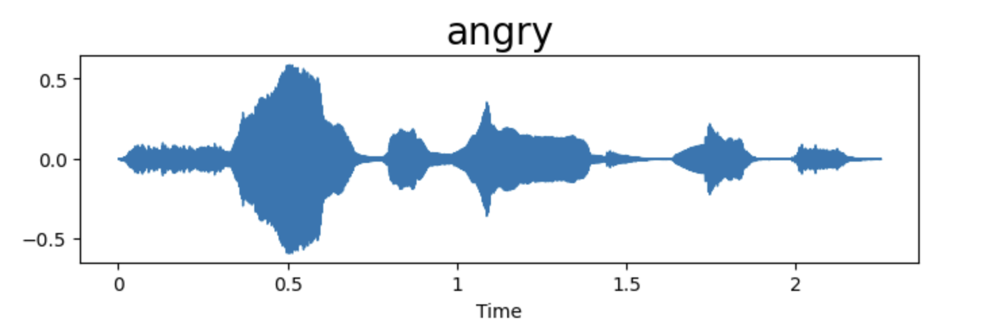
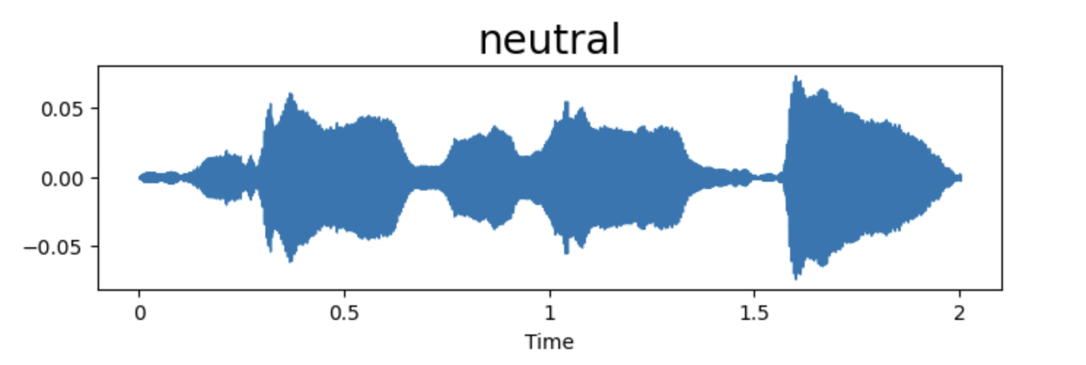
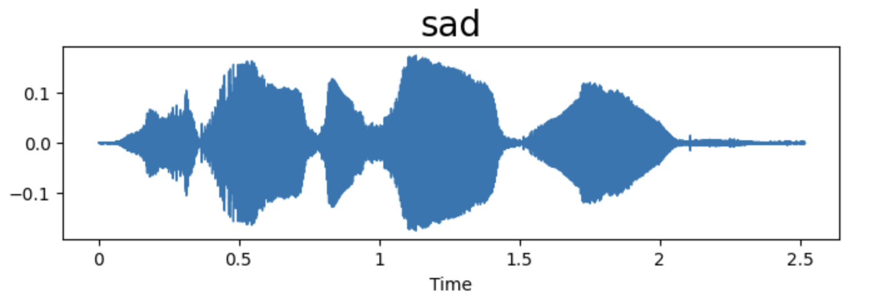
Stress analysis using waveform plot
Extracted amplitude(intensity) of all stress events and how each emotion differs from one and other. These visualization shows the waveform for the “fear”“anger”, “sadness”, “neutral”, “disgust” events in an audio sample.

Slide 22
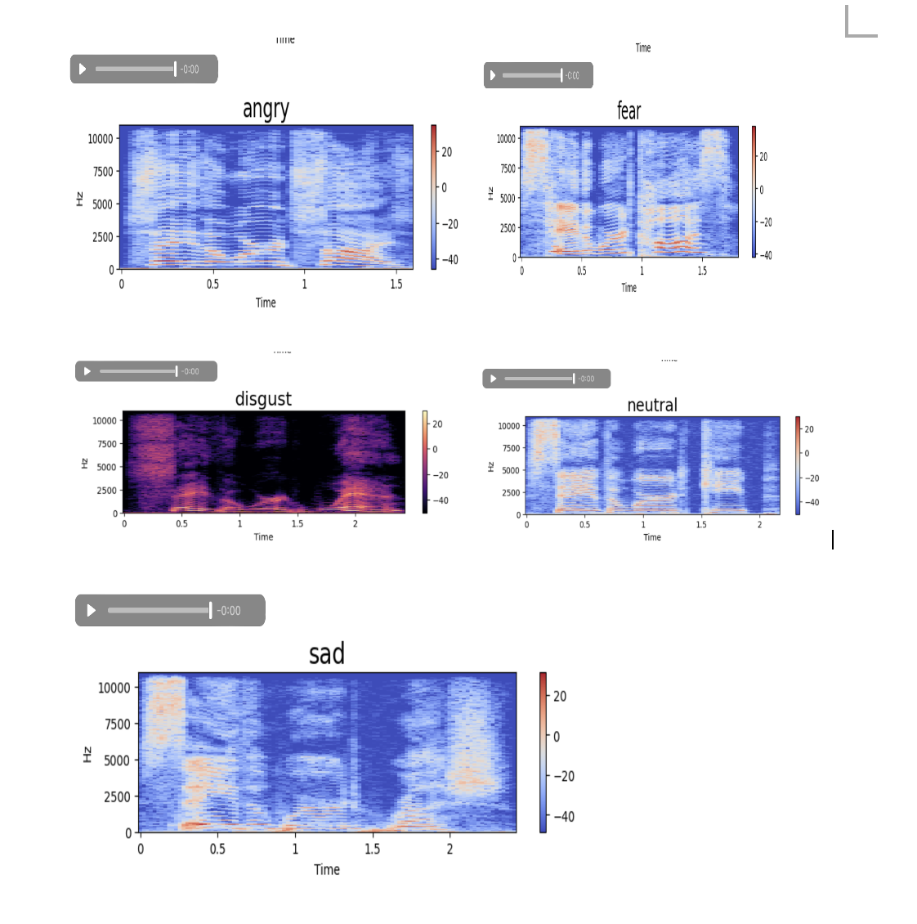
Stress analysis using spectogram plot
This analysis identify the stress situations (sadness, fear, neutral,anger) from voice.
Extracted frequency of all stress events and how each emotion differs from one and other. These visualization shows the spectrogram for the “fear”“anger”, “sadness”, “neutral”, “disgust” events in an audio sample.
19

Slide 23
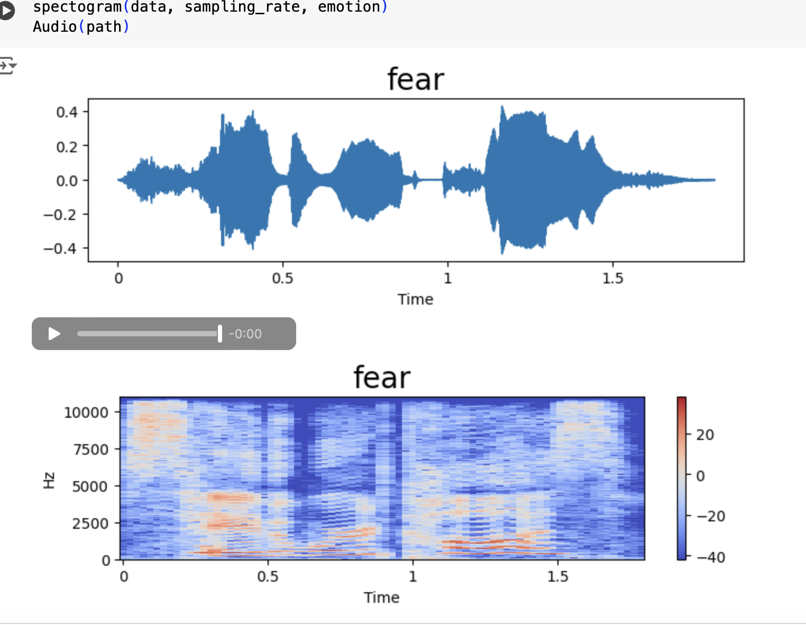
Waveform and spectogram plot of “fear”
Waveform: Represents the amplitude (Intensity) of the "fear" audio signal over time.
The x-axis is time (in seconds) and the y-axis is amplitude. The amplitude range here is slightly larger ( -0.4 to 0.4), indicating expression of fear.
The variations in the waveform indicate the changes in loudness over time, which is characteristics of the "fear".
Spectrogram: Shows the frequency over time, with frequencies represented on the y-axis (in Hertz) and time on the x-axis.
The color scale on the right indicates intensity in decibels (dB), warmer colors (red) showing higher intensity and cooler colors (blue) showing lower intensity.
20
Notes:
The spectrogram helps visualize which frequencies are prominent during different parts of the "fear" expression.

Slide 24
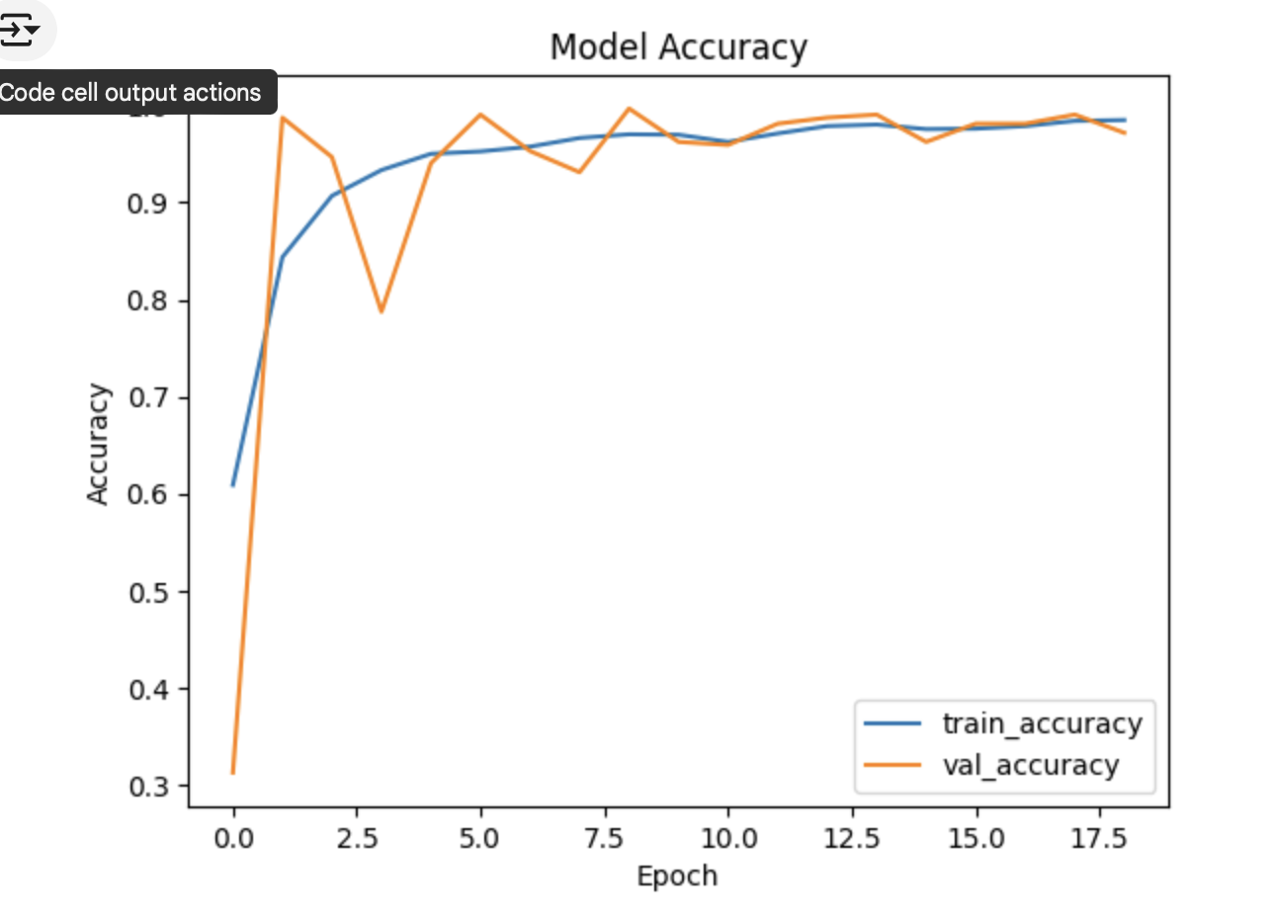
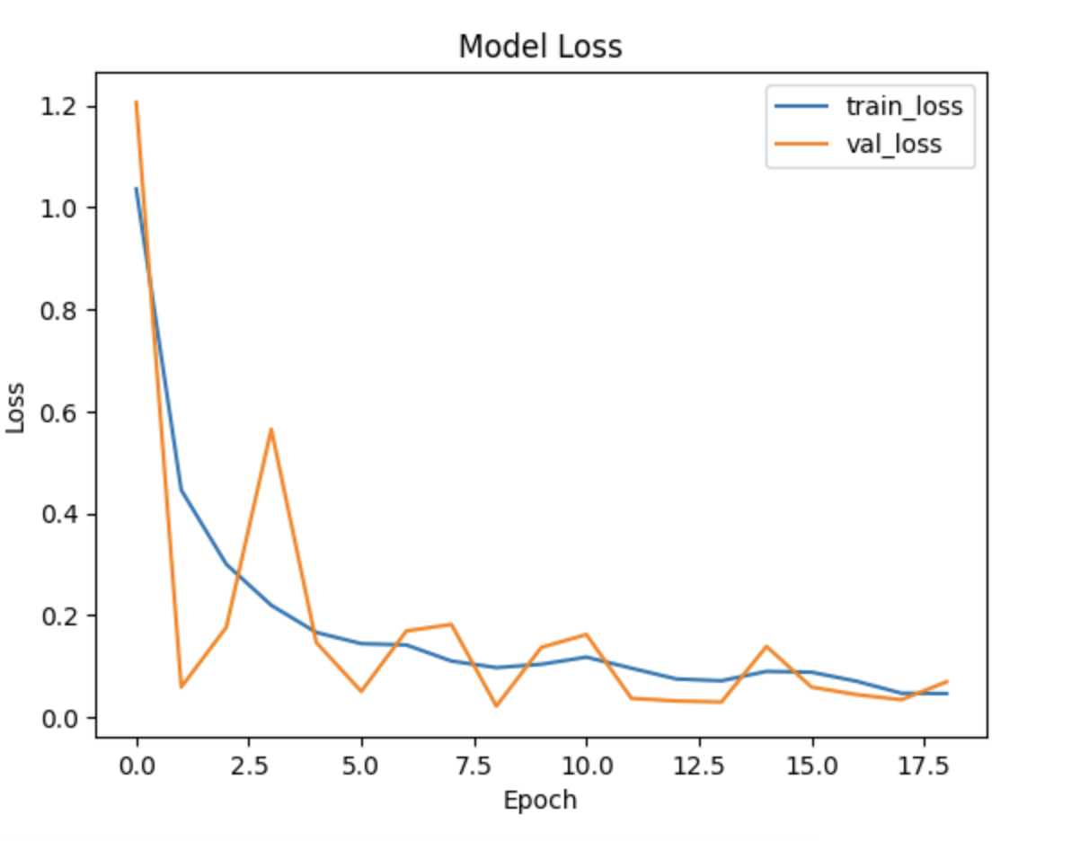
Proposed LSTM model
LSTM (Long Short-Term Memory): For sequential data like audio, speech, and time series.
Learn temporal dependencies and well-suited for tasks where the order of data points matters (ex: stress levels over time, changes in tone or pitch).
Training and validation ratio: 80:20
Highest Training Accuracy: 0.9861 (Epoch 19)
Highest Validation Accuracy: 0.9969 (Epoch 9)
Training accuracy to be slightly lower than validation accuracy
Regularization techniques(Dropout, L2 Regularization, Data Augmentation) are used.
The validation set is simpler and less noisy.
21
Notes:
Randomly dropping neurons, penalizing large weight, creating slightly alter version of training data.

Slide 25
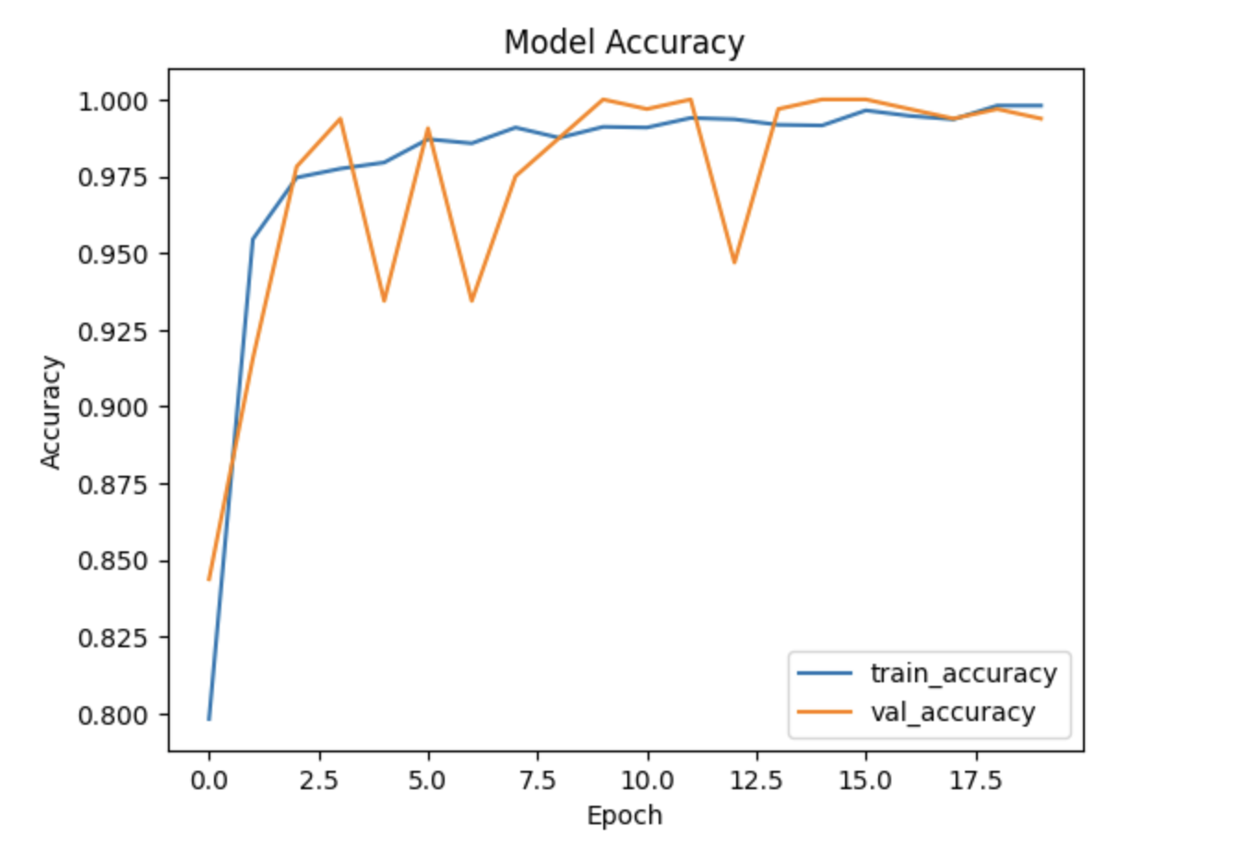
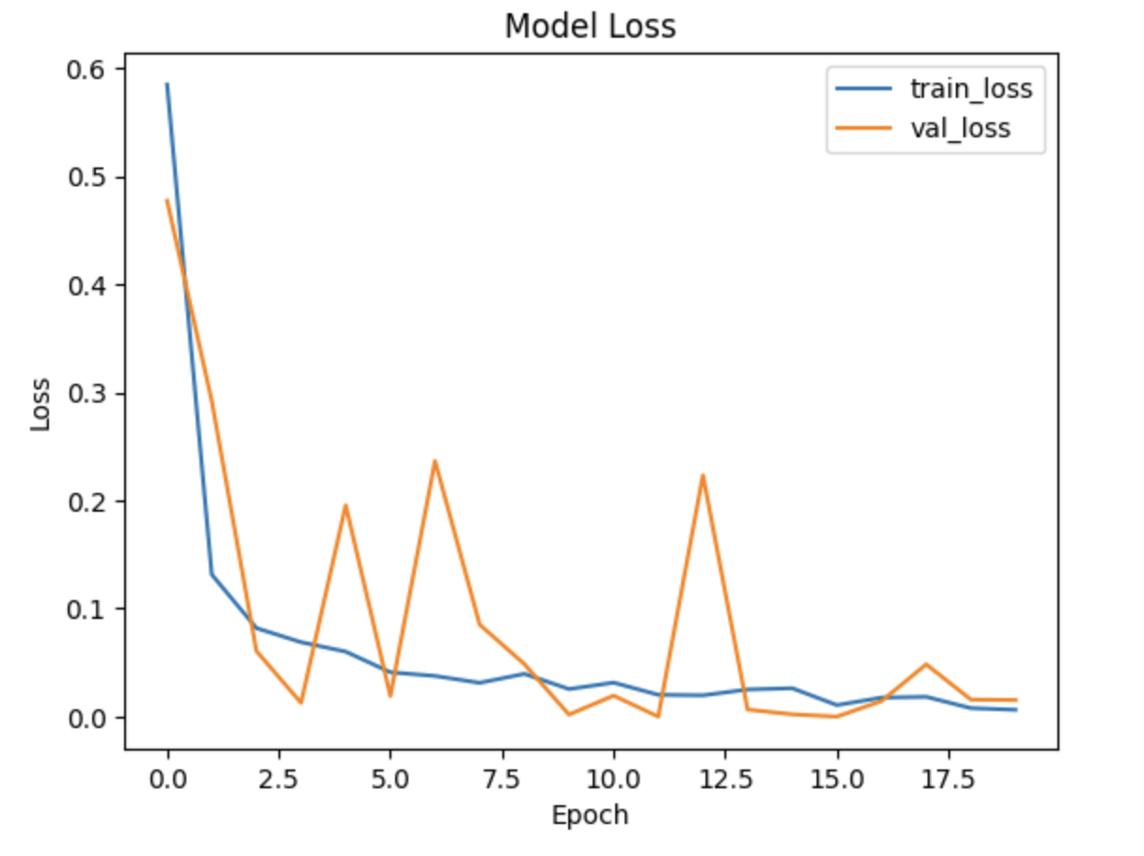
Compared to CNN model
CNN (Convolutional Neural Network): For audio data, CNNs are often applied to spectrograms (visual representations of audio frequency over time), treating them as images.
Both the LSTM and CNN models reach high levels of accuracy, but there are key differences in their performance.
Stability: The LSTM model shows more consistent accuracy across epochs with minimal fluctuation in validation accuracy, indicating better stability
Handling Temporal Patterns: LSTMs are designed to capture sequential dependencies in time-series data, more suitable for audio analysis in tasks that require understanding stress patterns over time. CNNs, while powerful for feature extraction, don’t inherently account for time dependencies, which lead to less accurate stress predictions over time.
Validation Accuracy Fluctuation: The CNN model shows more fluctuation in validation accuracy, which indicate potential overfitting to the training data and variations in the validation set. This make the CNN model less reliable.
22
Notes:
Generalization: The LSTM’s smooth convergence and close alignment of training and validation accuracy suggest it generalizes better to unseen data, which is important for a robust real-world stress detection system.

Slide 26
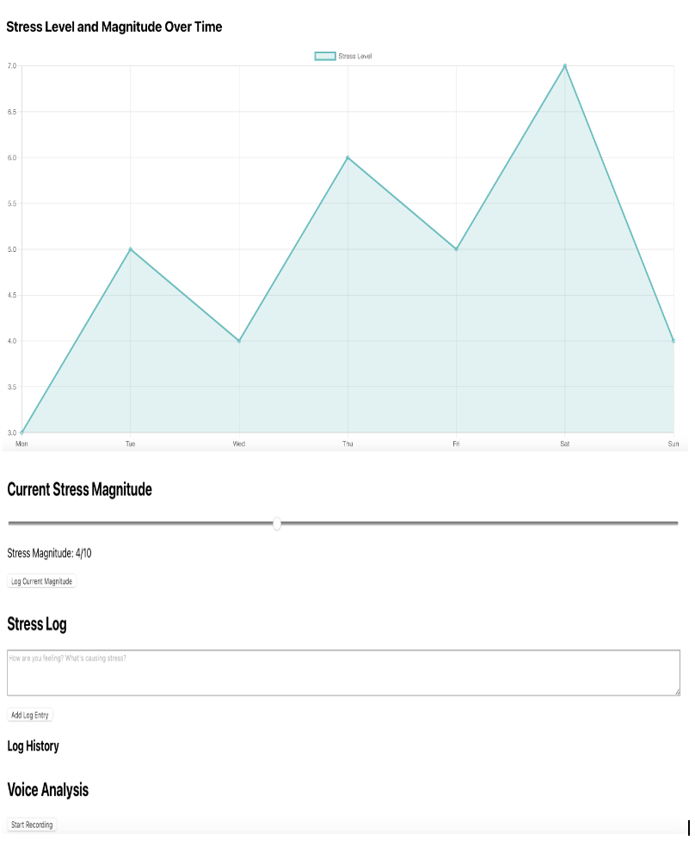
Interface for monitoring and logging stress levels

Slide 27
Key elements
Graph (Stress Level and Magnitude Over Time) : This line graph tracks stress levels over a week, with each day labelled (Monday to Sunday) along the x-axis. The y-axis represents the stress magnitude, ranging from 3.0 to 7.0. The graph shows fluctuations in stress levels throughout the week, with visible peaks and drops.
Current Stress Magnitude Slider – A slider allows users to log their current stress magnitude, which is currently set at 4/10. There’s a button labelled “Log Current Magnitude” to save the input.
Stress Log : A text box is provided for users to describe their feelings or the causes of stress. There's a button to “Add Log Entry” below the text box.
Log History – This section is where previously entered stress logs are stored, but no data is currently visible.
Voice Analysis Section : This section appears to allow voice recordings for analysis. It includes a “Start Recording” button, likely to initiate a voice-based stress analysis feature.
24

Slide 28
Future consideration
Comparing with tool like OpenSmile
Prosodic feature: loudness, energy
Spectral features: spectral bandwidth, spectral contrast.
Voice quality features: Jitter, shimmer.
Real time Facial expression recognition.
Mental health dialogue system for personalized support.
25
Notes:
Jitter: Variability in pitch over time.
Shimmer: Variability in amplitude over time.
Energy: Overall loudness of the voice.

Slide 29
Conclusion
Summary: This system will combine advanced SSP techniques with LLM capabilities to support stress detection and mental health care.
26

Slide 30
References
[1] Schneeberger, Tanja, et al. ”The deep method: Towards computational modeling of the social emotion shame driven by theory, introspection, and social signals.” IEEE Transactions on Affective Computing (2023).
[2] Yongsatianchot, Nutchanon, Parisa Ghanad Torshizi, and Stacy Marsella. ”Investigating large language models’ perception of emotion using appraisal theory.” 2023 11th International Conference on Affective Com- puting and Intelligent Interaction Workshops and De- mos (ACIIW). IEEE, 2023.
[3] Jaiswal, Mimansa, and Cristian-Paul Bara. ”Muse: a multimodal dataset of stressed emotion.” Proceedings of the Twelfth Language Resources and Evaluation Conference. 2020.
[4] Sun, Congshan, Haifeng Li, and Lin Ma. ”Speech emotion recognition based on improved masking EMD and convolutional recurrent neural network.” Frontiers in Psychology 13 (2023): 1075624.
27

Slide 31
Thank you

Slide 32
Question?

Slide 33
Key elements
Graph (Stress Level and Magnitude Over Time) : This line graph tracks stress levels over a week, with each day labelled (Monday to Sunday) along the x-axis. The y-axis represents the stress magnitude, ranging from 3.0 to 7.0. The graph shows fluctuations in stress levels throughout the week, with visible peaks and drops.
Current Stress Magnitude Slider – A slider allows users to log their current stress magnitude, which is currently set at 4/10. There’s a button labelled “Log Current Magnitude” to save the input.
Stress Log : A text box is provided for users to describe their feelings or the causes of stress. There's a button to “Add Log Entry” below the text box.
Log History – This section is presumably where previously entered stress logs are stored, but no data is currently visible.
Voice Analysis Section : This section appears to allow voice recordings for analysis. It includes a “Start Recording” button, likely to initiate a voice-based stress analysis feature.
18

Slide 34
Voice feature analysis method
Prosodic Analysis: Pitch, loudness, rhythm, and intonation (highly useful for stress detection).
Spectral Analysis: MFCCs, formants, and frequency content.
Time-Domain Analysis: Amplitude, energy, and zero crossing rate.
Voice Quality Analysis: Jitter, shimmer, and HNR.
Formant Analysis: Formant shifts related to vocal tension.
20
Notes:
Mel-Frequency Cepstral Coefficients, Harmonics-to-Noise Ratio,

Slide 35
Some stress visualization technique
Waveform Visualization: Displays the amplitude of the voice signal over time.
Pitch Contour Visualization: Shows how the pitch varies over time.
Spectrogram Visualization: A visual representation of the voice's frequency content over time.
Energy Intensity Visualization: Shows how the loudness (energy) changes in the voice.
Jitter and Shimmer Plots: Visualizes variability in pitch and amplitude.
Emotion Flow: Tracks changes in emotional states, such as stress or calmness, over time.
Radar Chart: Plots multiple voice features (pitch, jitter, shimmer) on different axes to show stress levels.
20

Slide 36
Voice feature
Pitch: The fundamental frequency of the voice (F0).
Jitter: Variability in pitch over time.
Shimmer: Variability in amplitude over time.
Energy: Overall loudness of the voice.
Spectral Features: Frequency distribution in the voice signal.
Speech Rate: The speed at which the person is speaking.
Formants: Resonant frequencies of the vocal tract

Slide 37
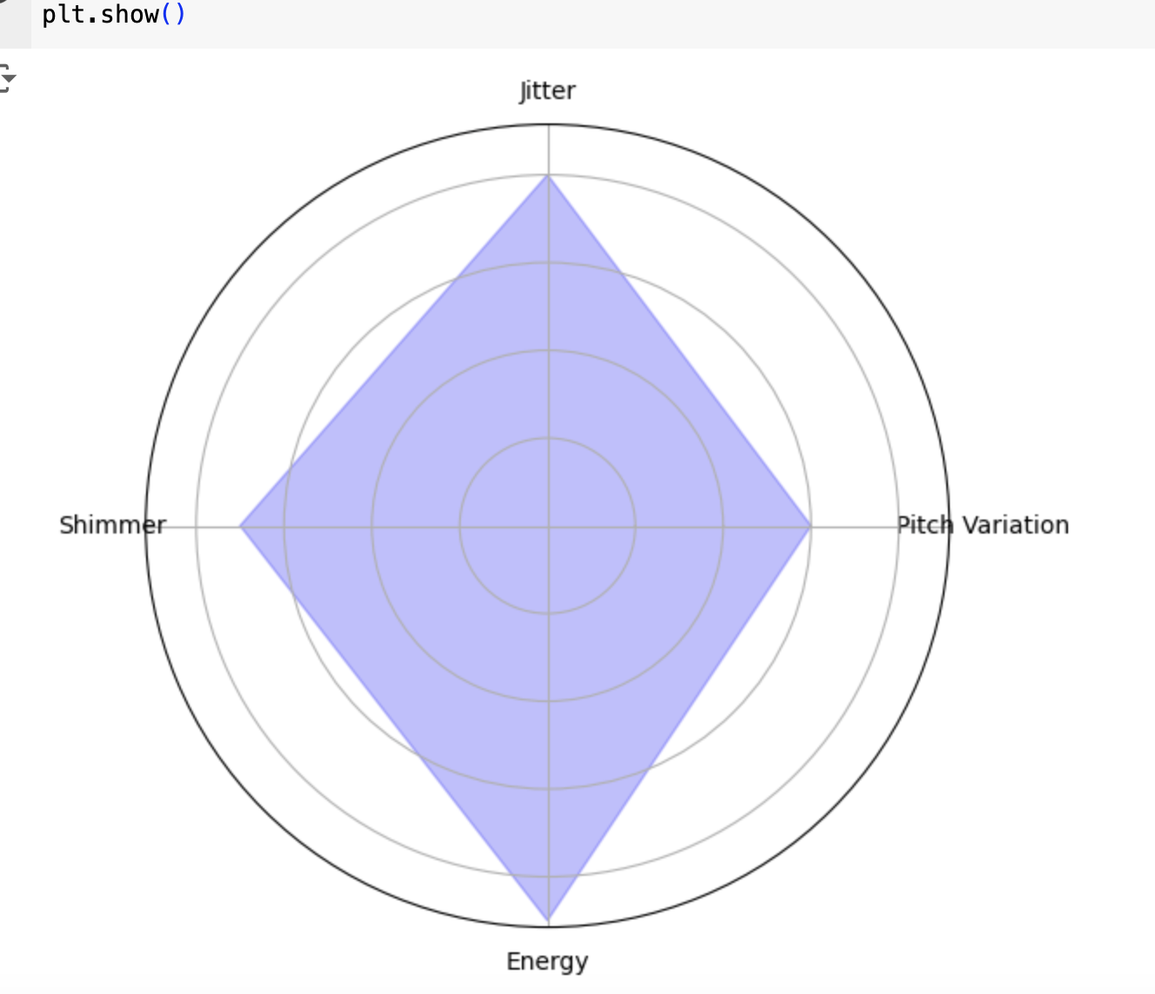
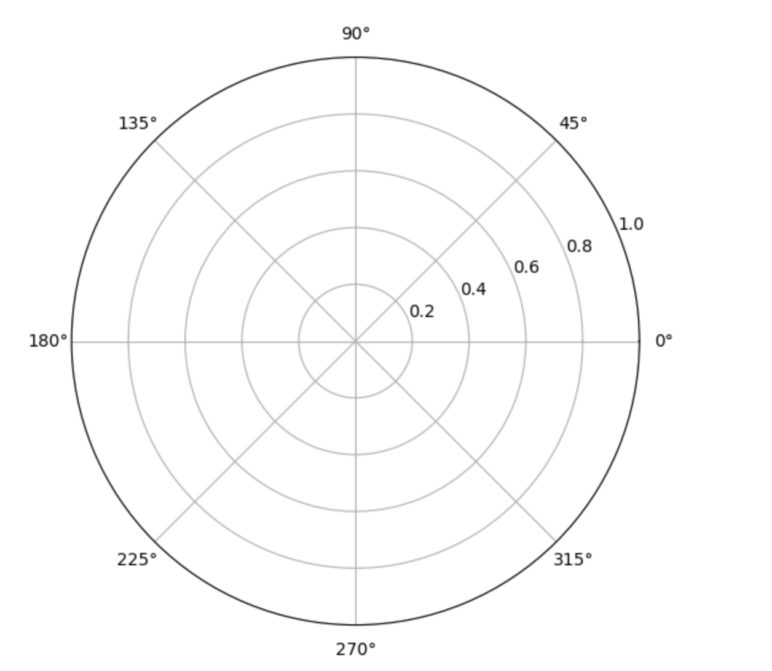
Stress radar(spider plot)
various stress-related vocal features and plot them on different axes of the radar chart. The more the chart expands outward (towards the high values for each feature), the higher the stress level.

Slide 38
Prosdy signal for stress visualization
Pitch
Speech rate
Intensity (loudness)
Shimmer and voice Jitter
Pause and hesitations
Formants frequencies

Slide 39





Example of workflow
→
→
→
→
Voice is analyzed (features + transcription)
User speaks
LLM evaluates stress level
Stress level is sent to visual dashboard
Graph is updated
9
Notes:
User speaks → 2. Voice is analyzed (features + transcription) → 3. LLM evaluates stress level → 4. Stress level is sent to visual dashboard → 5. Graph is updated

Slide 40
Stress elements

Slide 41
Prosody and voice

Slide 42
Pitch (Fundamental Frequency) 音高)
Description: Stress often causes a rise or fall in pitch, leading to higher or more variable frequency in speech.
Visualization: Visualize pitch variations over time as a wave or line plot, showing moments where pitch escalates or dips. High-frequency spikes often indicate stress

Slide 43
Speech Rate(発語速度）
Description: People under stress may speak faster or slower than usual. Speech rate, measured in syllables per second, is a clear indicator of anxiety or calmness.
Visualization: A bar or line graph can show speech rate fluctuations over time. Peaks in speech rate correlate with heightened stress or tension

Slide 44
Intensity (Loudness)
Description: Loudness tends to increase during moments of stress. A person may speak more forcefully or at a higher volume.
Visualization: A heatmap can represent loudness intensity, with varying color gradients showing changes in loudness. Red or bright colors can indicate high intensity and potential stress.

Slide 45
Voice Jitter and Shimmer
Description: Jitter (variability in pitch) and shimmer (variability in loudness) tend to increase when someone is stressed, leading to more unstable or irregular speech patterns.
Visualization: Line charts displaying jitter and shimmer changes can show where speech becomes unstable, signaling potential stress.

Slide 46
Pauses and Hesitations
Description: Longer pauses or frequent hesitations in speech can indicate cognitive load or emotional stress.
Visualization: Gantt charts or bar graphs that map speech segments can show where pauses occur, with longer gaps signaling potential stress

Slide 47
Formant Frequencies
Description: Formants represent resonance frequencies in the voice and change with emotional arousal or tension.
Visualization: Spectrograms can visually represent formant frequencies, with stress regions showing up as color or shape changes in the spectrum

Slide 48
Future work
Real time Facial expression recognition.
Visualization based on paralinguistic
Stress level visualization (non-verbal signal, emotion polarity, visualization-based prosody signal, heatmaps).
Mental health dialogue system for personalized support.
16

Slide 49
Stress radar(spider plot)

Slide 50
Future consideration
Visualization based on paralinguistic
Stress level visualization (non-verbal signal, emotion polarity, visualization-based prosody signal).
Real time Facial expression recognition.
Mental health dialogue system for personalized support.
16

Slide 51
{"prompt": "Analyse the following transcript for signs of distress and urgency."}.
Next Steps: Prototype development, testing with real-world data, and clinical trials.
Audio capture
How to visualize the stress
Current version of visualization is based on text
My slides can be improved by appending more meaningful future work.

Slide 52
Future Directions
Enhancing Accuracy: Improving algorithms for better stress prediction.
Broader Integration: Integrating with wearable devices (smartwatches, health trackers) for a more holistic approach.
AI-Empowered Therapy: Further development of the dialogue system into a full-fledged therapeutic assistant.

Slide 53



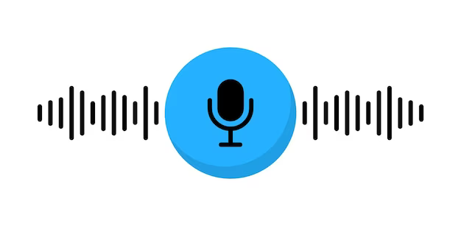



Texual Network
Stress Level
Transcript
Prompt
Texual Network

Slide 54
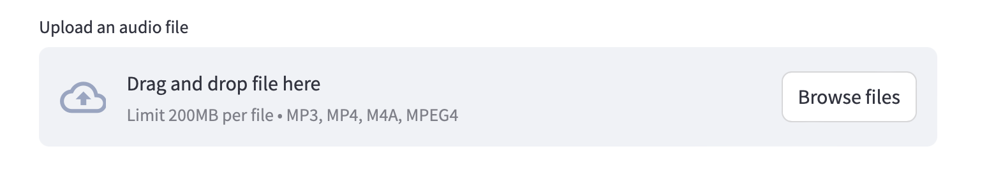
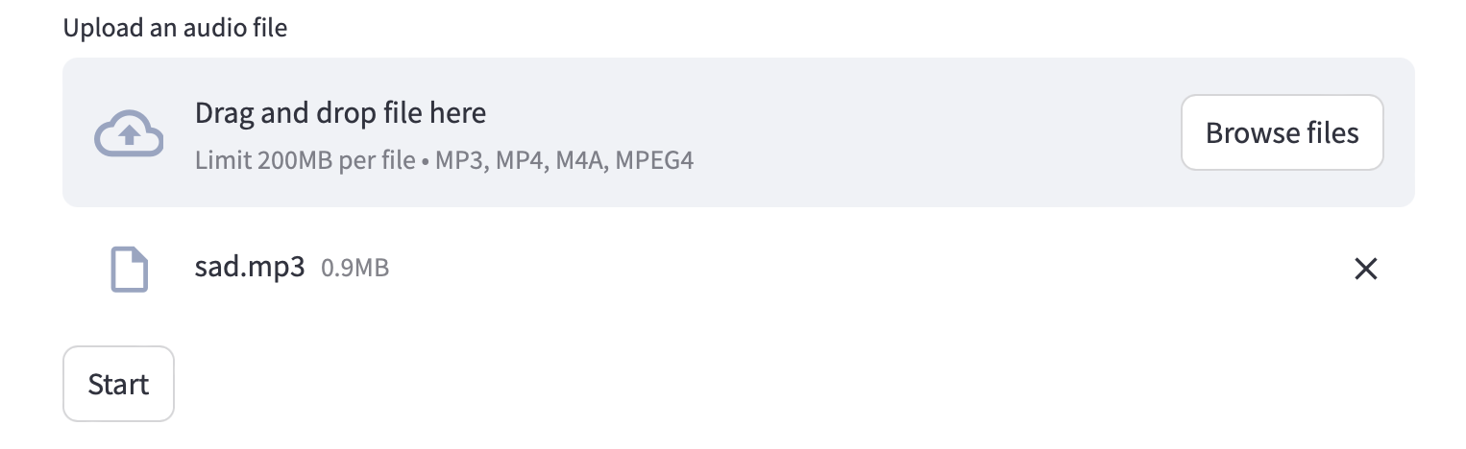

Slide 55
Social Signal Processing Techniques
Facial Expression Recognition: Detects emotions (anger, sadness, happiness) through micro-expressions and facial cues.
Voice Feature Analysis: Analyses pitch, tone, speed, and other vocal elements to assess stress and emotional states.
Data fusion: Merges facial and voice data for a more accurate and comprehensive stress assessment.
5

Slide 56



ホサイン シエダ タンジイナ
自己紹介
バングラデシュ
工学専攻 情報工学系プログラム (M2)
35414100
cnq14100@ict.nitech.ac.jp
syedatanzin@gmail.com
趣味
ガーデニング 料理
愛知県のものづくり企業で働きたい

